Slide 1



What’s next in AI for glaucoma screening?
The REFUGE challenge outcomes
José Ignacio Orlando, PhD
Yatiris Group, PLADEMA Institute, UNICEN
National Scientific and Technical Research Council (CONICET)

Slide 3
Opportunities for AI in glaucoma
Screening
Follow up / prognosis
Treatment planning
Disease understanding

Slide 4
Opportunities for AI in glaucoma
Screening
Follow up / prognosis
Treatment planning
Disease understanding

Slide 5
Types of screening
Population based (universal)
Case detection (opportunistic)
COST EFFECTIVENESS!

Slide 6
+ Accuracy
Genetics
Visual fields /
microperimetry
OCT
Fundus photograph
- Accuracy
IOP
- Cost!
+ Cost!

Slide 7
How to reduce the cost of glaucoma screening using AI?

Slide 8
The Diabetic Retinopathy experience

Slide 9
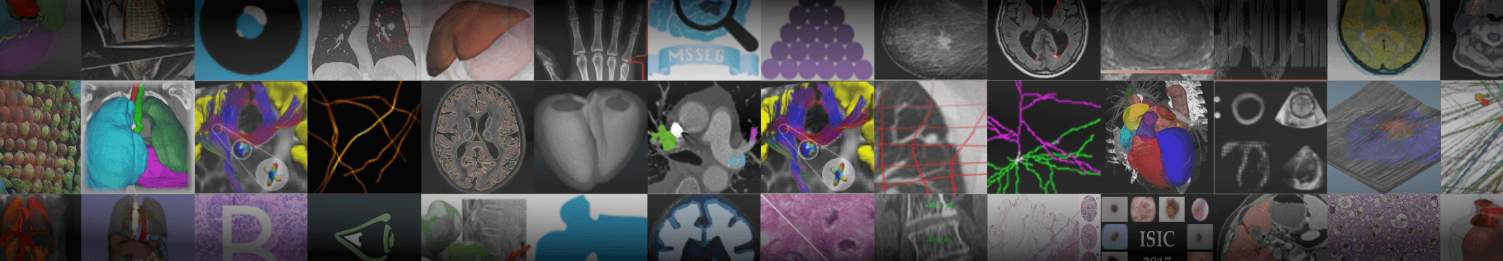
Grand challenges

Slide 10
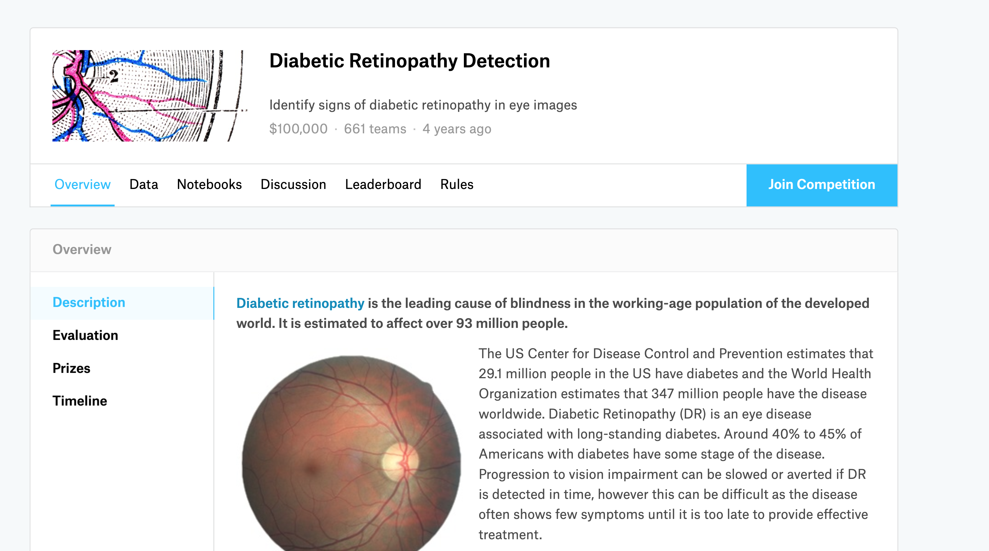


Slide 11
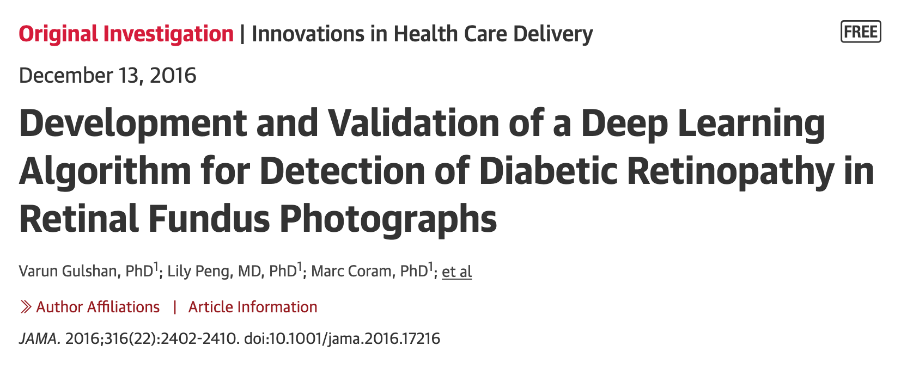
Gulshan et al., JAMA, 2016

Slide 12
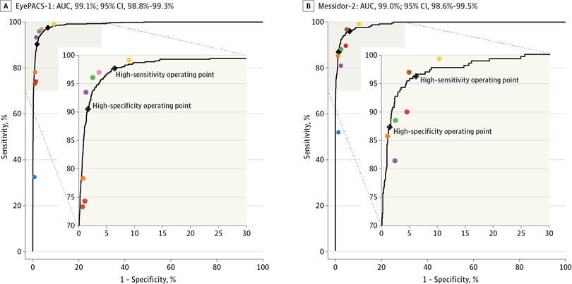
Gulshan et al., JAMA, 2016

Slide 13
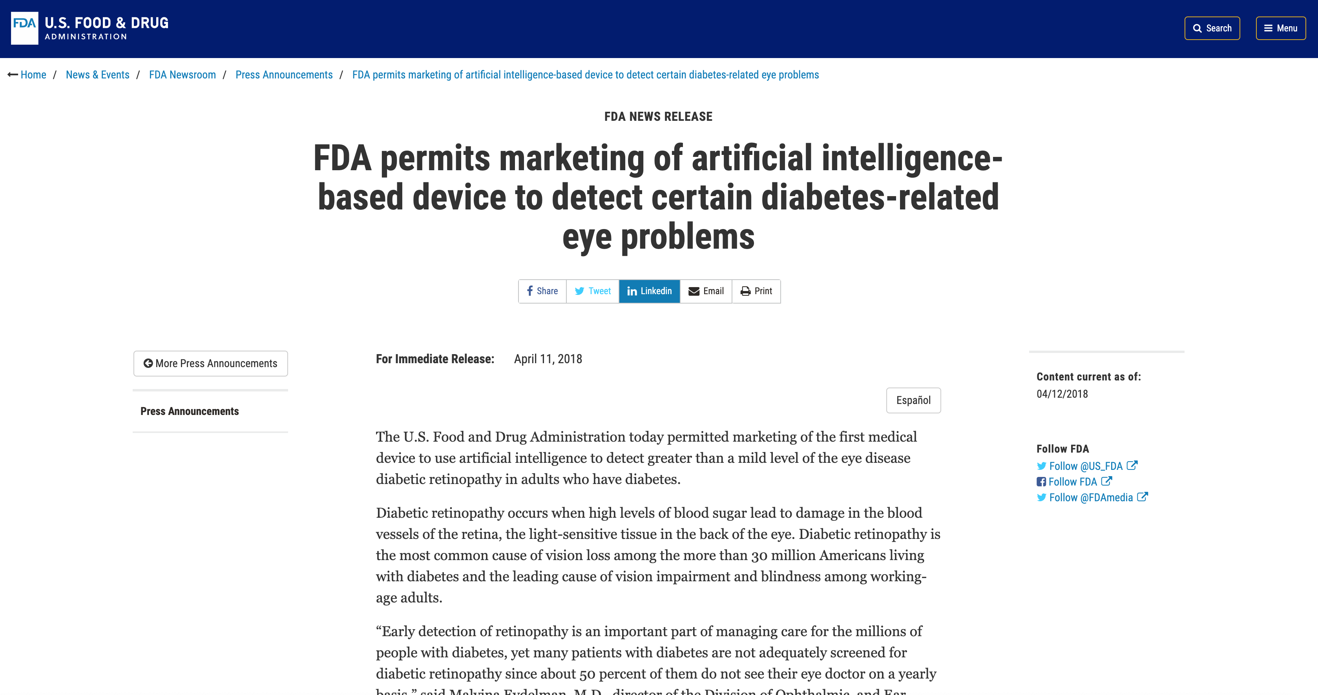

Slide 14
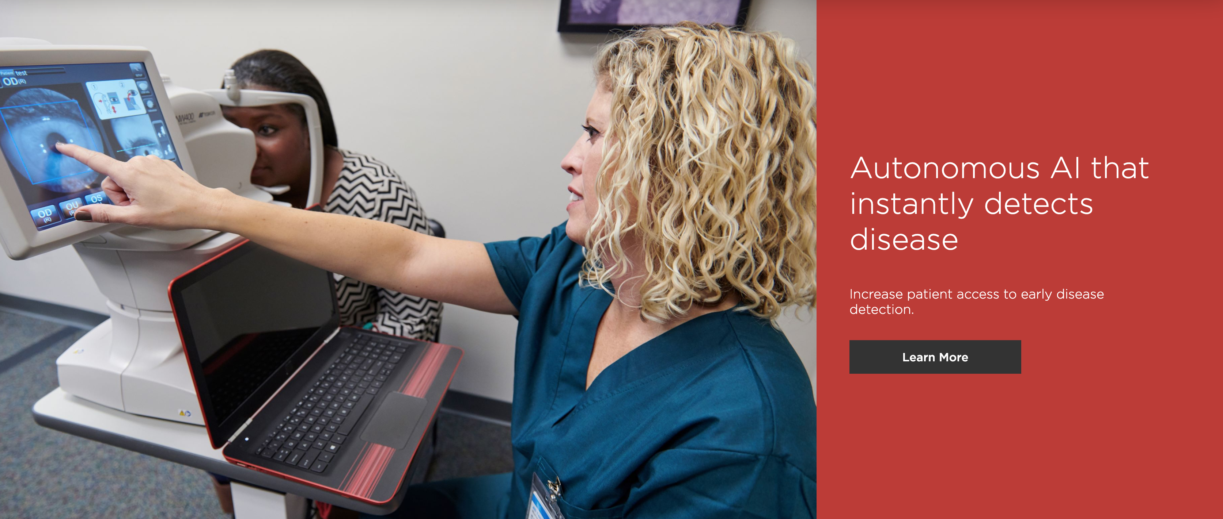

https://www.eyediagnosis.co

Slide 15
But…
Glaucoma features less evident in fundus images
Glaucoma as a multimodal disease
High cost of building (huge) reliable data sets
Clinical records based labels + Scrapping on clinical databases

Slide 16
+ Accuracy
Genetics
Visual fields /
microperimetry
OCT
Fundus photograph
- Accuracy
IOP
- Cost!
+ Cost!

Slide 17

Retinal Fundus Glaucoma Challenge
20th September, Granada, Spain
OMIA Workshop, MICCAI 2018
Orlando et al., Medical Image Analysis, 2019

Slide 18
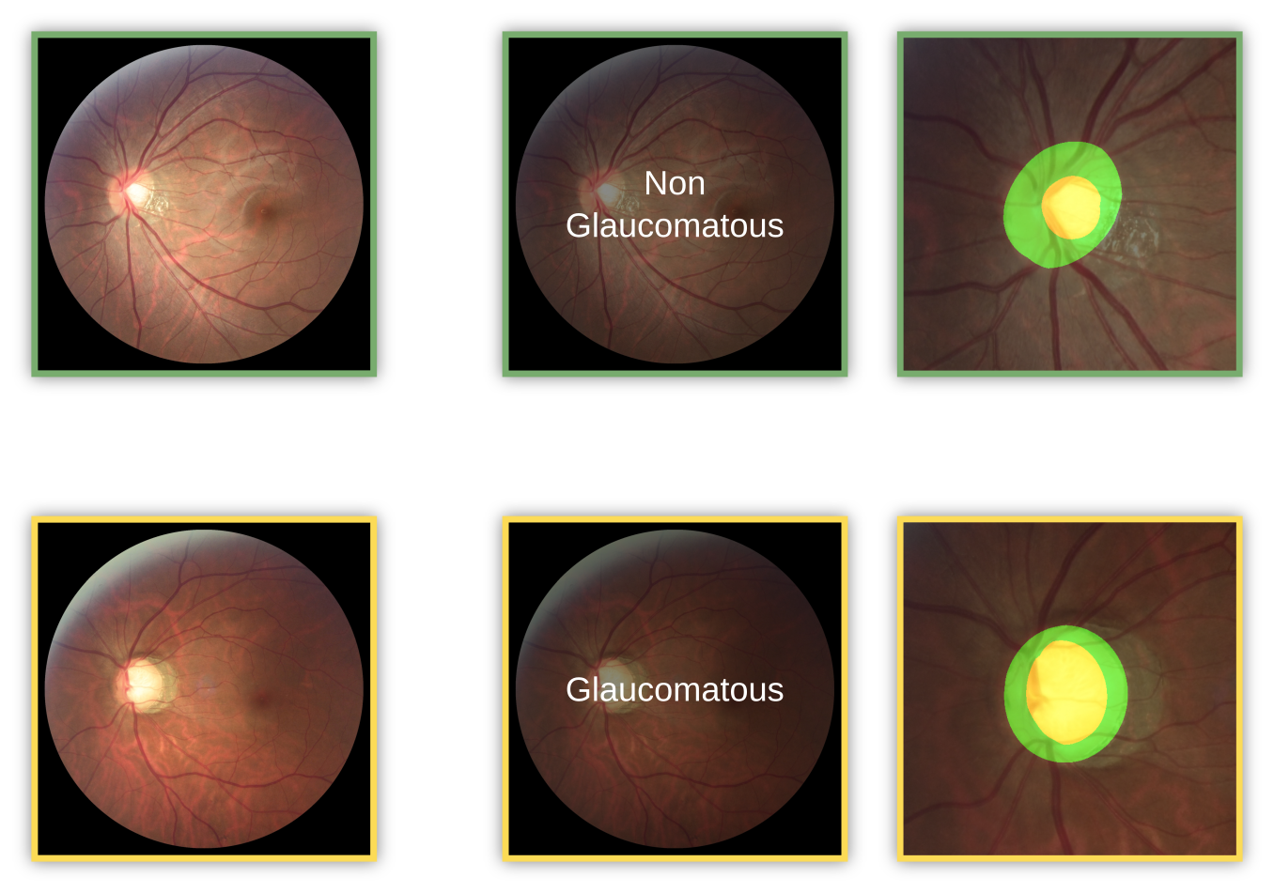
Orlando et al., Medical Image Analysis, 2019

Slide 19
The largest available data set of fundus pictures for glaucoma assessment
1200 images (10% glaucoma) divided in training, validation and test sets
Reliable annotations for glaucoma classification and optic disc/cup segmentation
Glaucoma labels retrieved from clinical records and optic disc/cup segmentations produced by +7 experts
A common evaluation framework to compare fundus image analysis methods for glaucoma
A test set with private labels + evaluation routines to report performance and prevent overfitting on test data
Orlando et al., Medical Image Analysis, 2019

Slide 20
Zeiss Visucam 500
Cannon CR-2
Cannon CR-2
400 images
400 images
400 images
Training
Offline evaluation
(labels are now available)
On-site evaluation
(private labels)
Orlando et al., Medical Image Analysis, 2019

Slide 21
12 participating teams
All the teams proposed deep learning based solutions!
Orlando et al., Medical Image Analysis, 2019

Slide 22
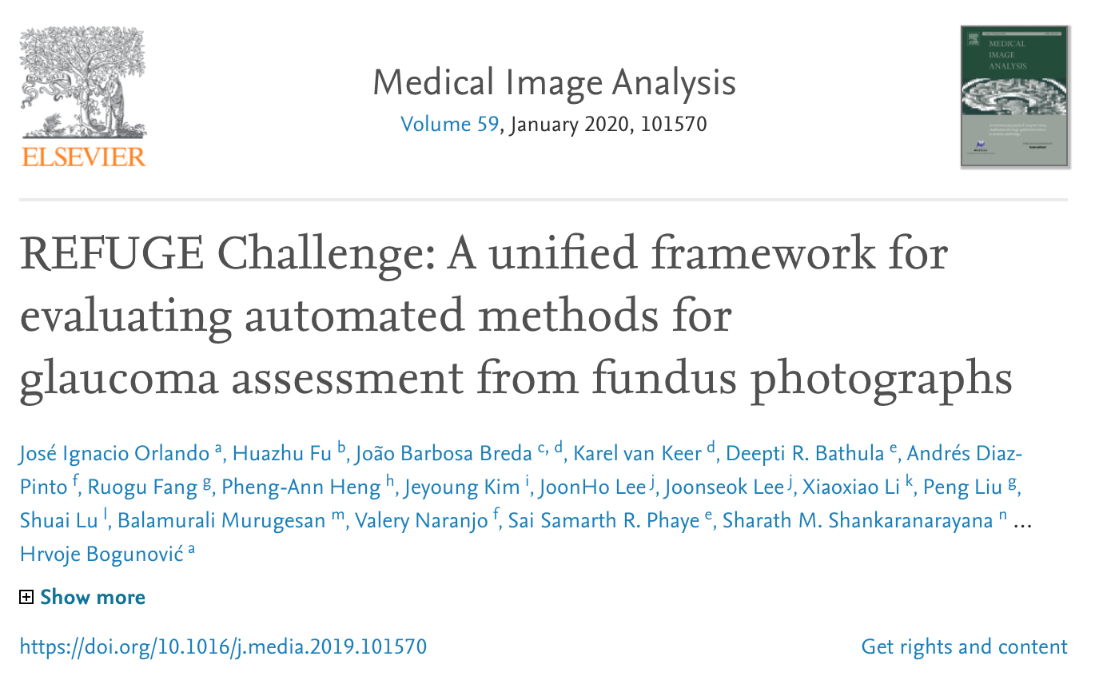

Slide 23
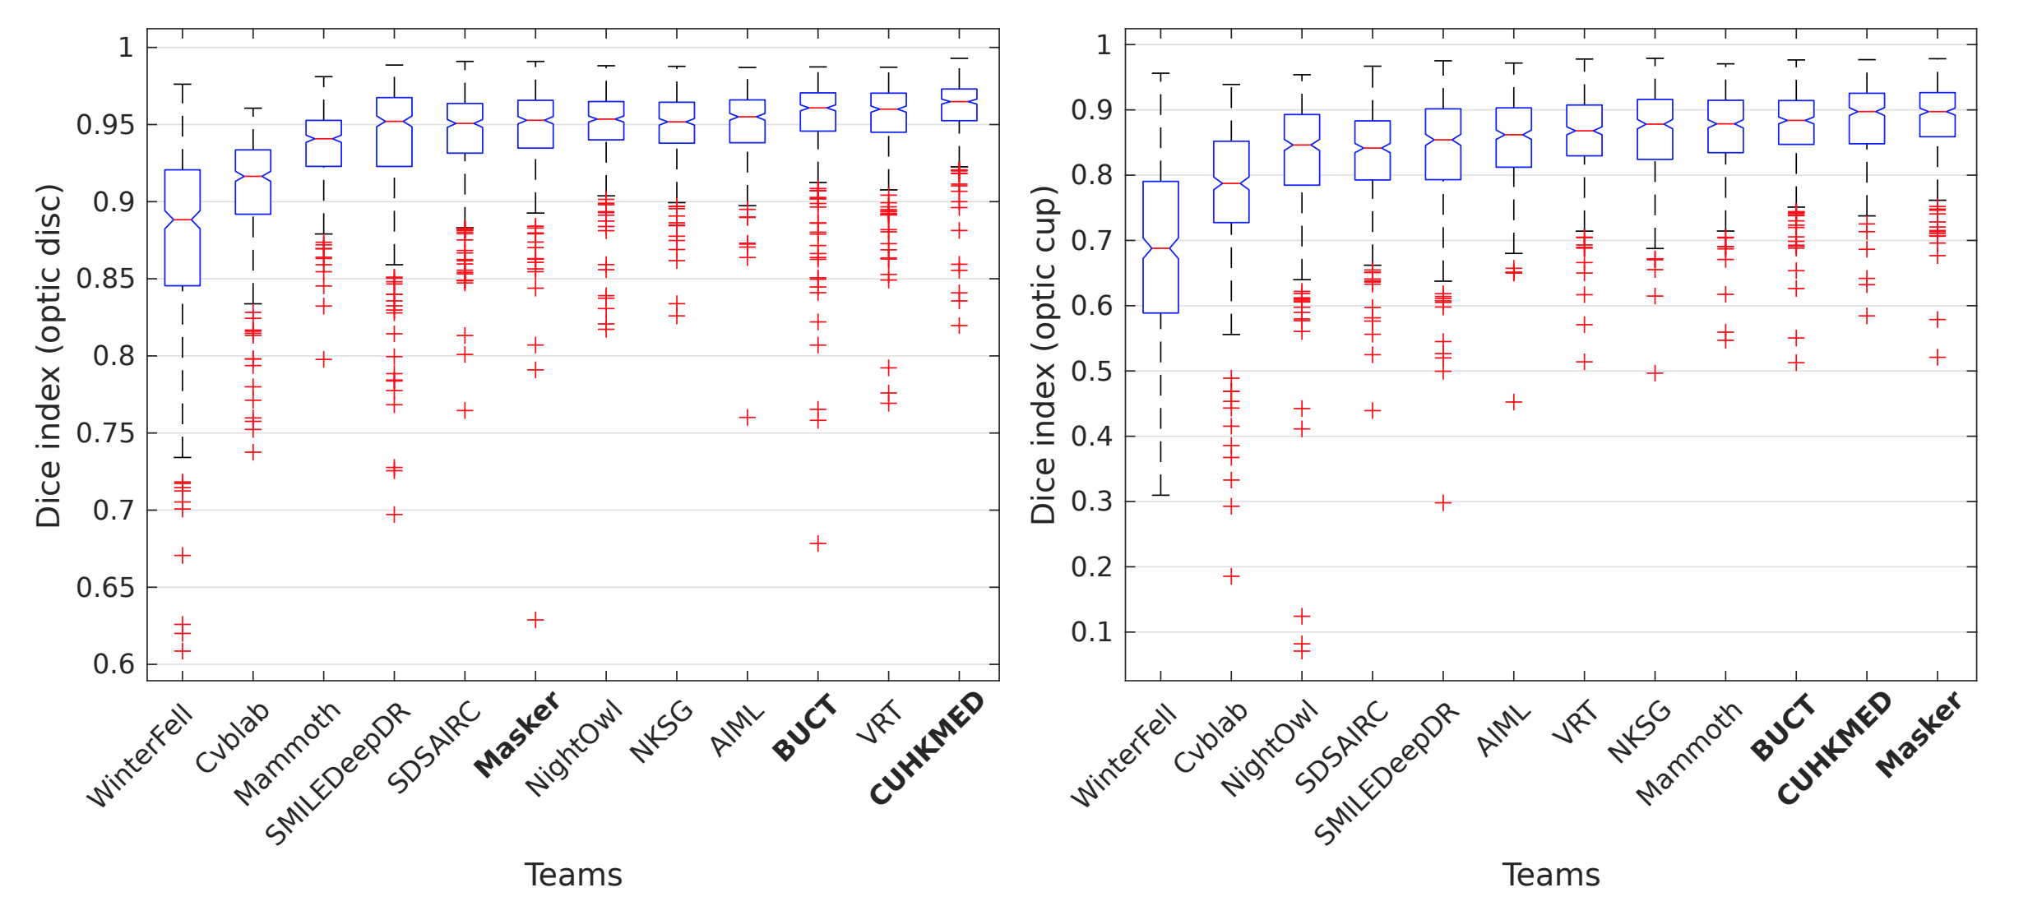
Optic disc/cup segmentation
Orlando et al., Medical Image Analysis, 2019

Slide 24
Glaucoma classification
Orlando et al., Medical Image Analysis, 2019

Slide 25
Still a long way to go to ensure that
the problem is solved

Slide 26
Future initiatives must consider
(I) Interpretability of the results → Class activation maps
Orlando et al., Medical Image Analysis, 2019

Slide 27
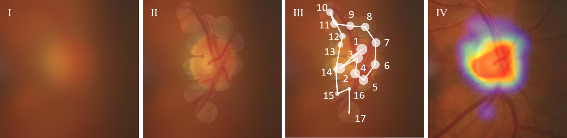
Interpretability of the results
LAG database: 11.760 images + image level annotations + attention maps (from “Attention Based Glaucoma Detection: A Large-Scale Database and CNN model”)
Li et al., CVPR, 2019

Slide 28
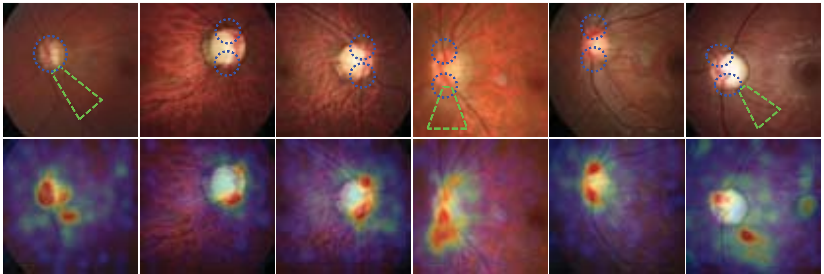
Interpretability of the results
Li et al., CVPR, 2019

Slide 29
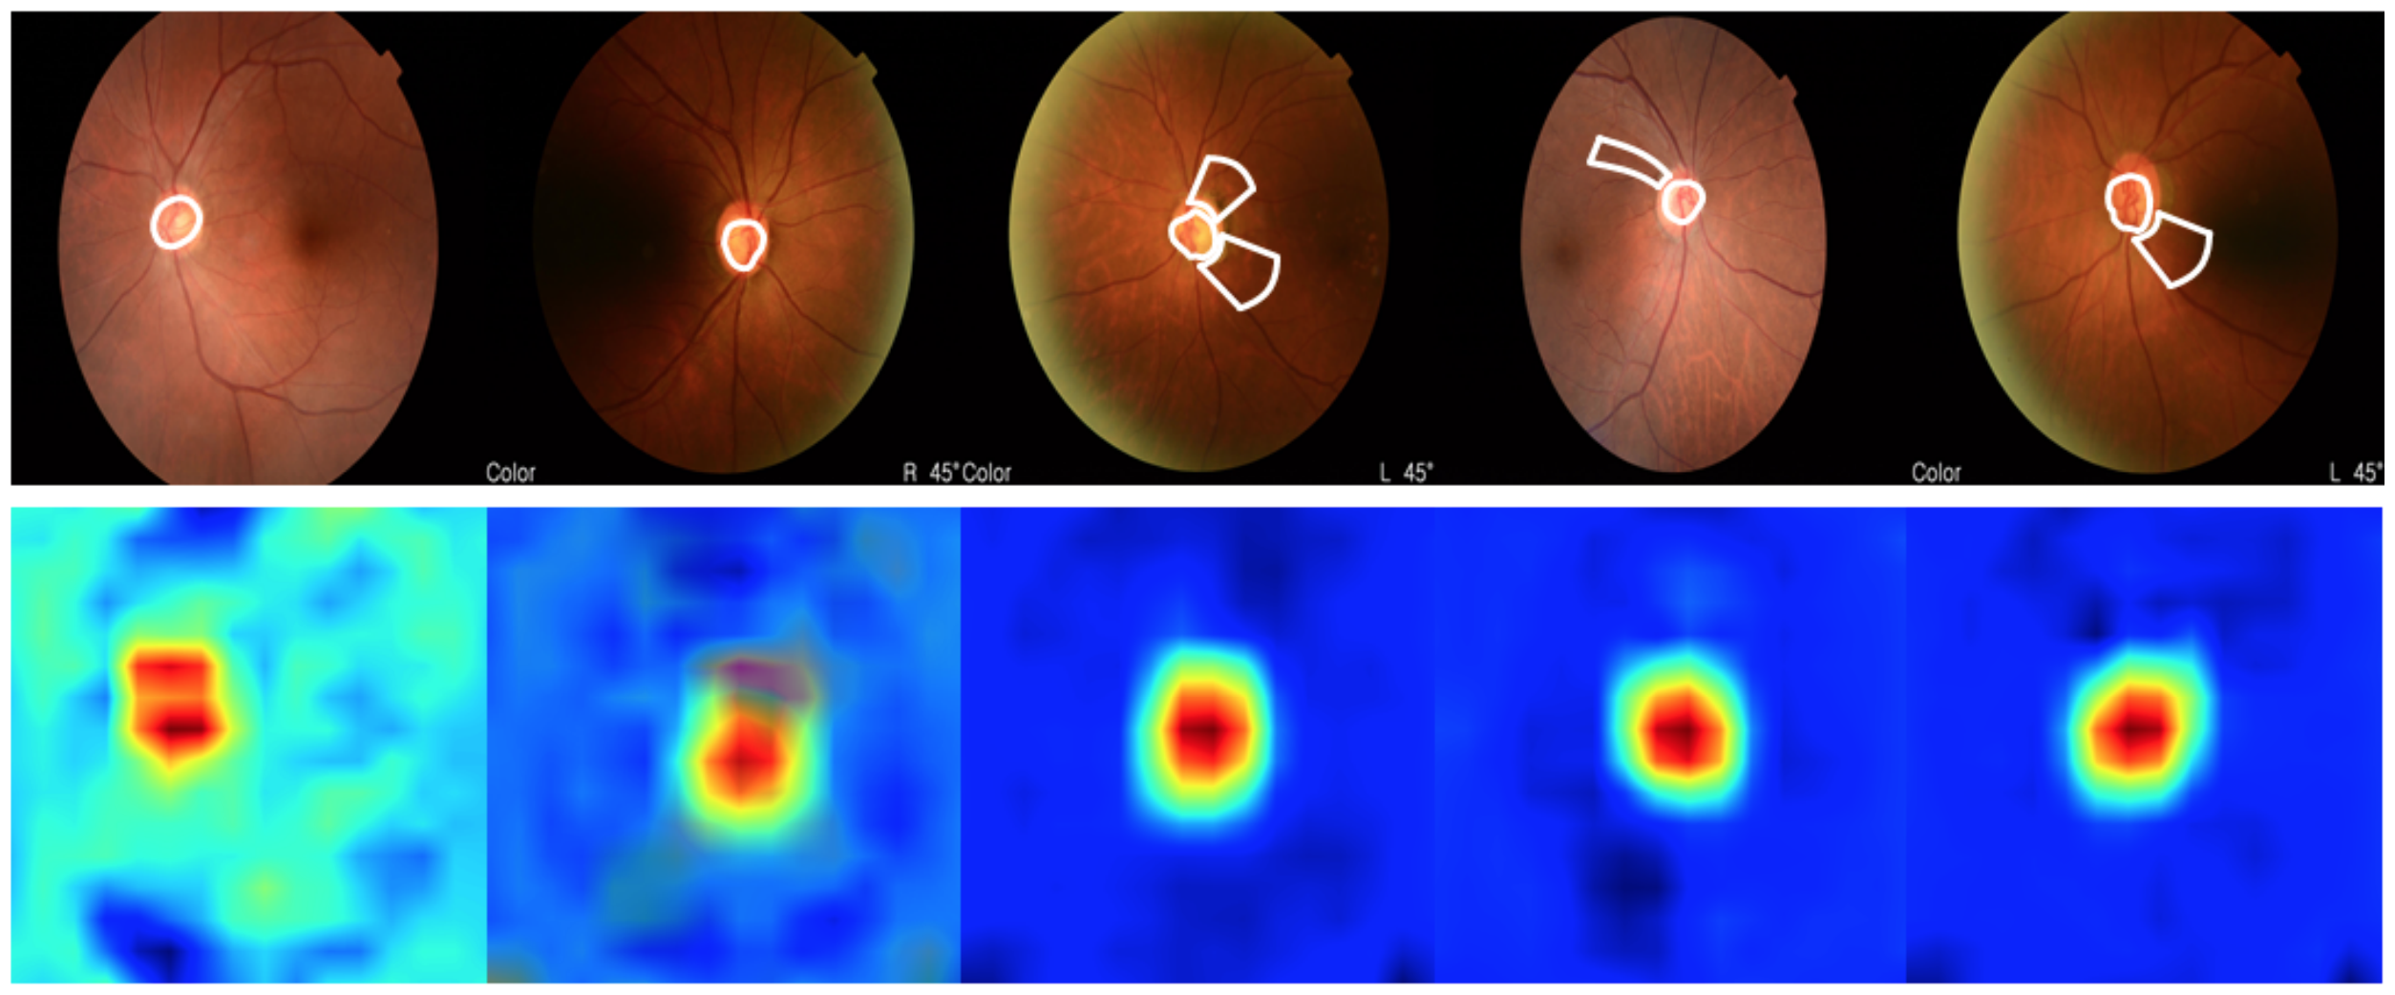
Interpretability of the results
Jun et al., BMVC, 2018

Slide 30
Future initiatives must consider
(I) Interpretability of the results → Class activation maps
(II) Larger / heterogeneous data sets (age, gender, ethnicities, acquisition quality, multiple devices, comorbidities, disease stages)
Orlando et al., Medical Image Analysis, 2019

Slide 31
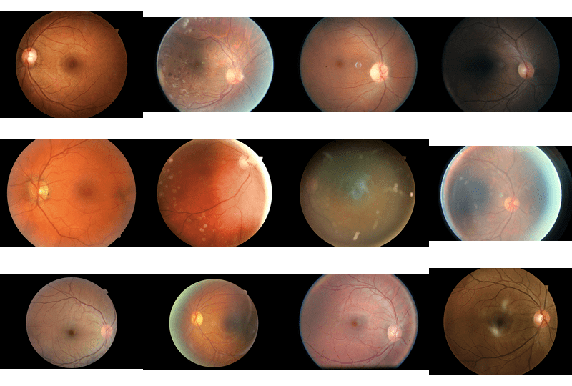
Larger + more heterogeneous data sets
http://blog.kaggle.com/2015/08/10/detecting-diabetic-retinopathy-in-eye-images/

Slide 32
Future initiatives must consider
(I) Interpretability of the results → Class activation maps
(II) Larger / heterogeneous data sets (age, gender, ethnicities, acquisition quality, multiple devices, comorbidities, disease stages)
(III) Annotations for other relevant structures (OD hemorrhages, RNFL defects, PPA)
Orlando et al., Medical Image Analysis, 2019

Slide 33
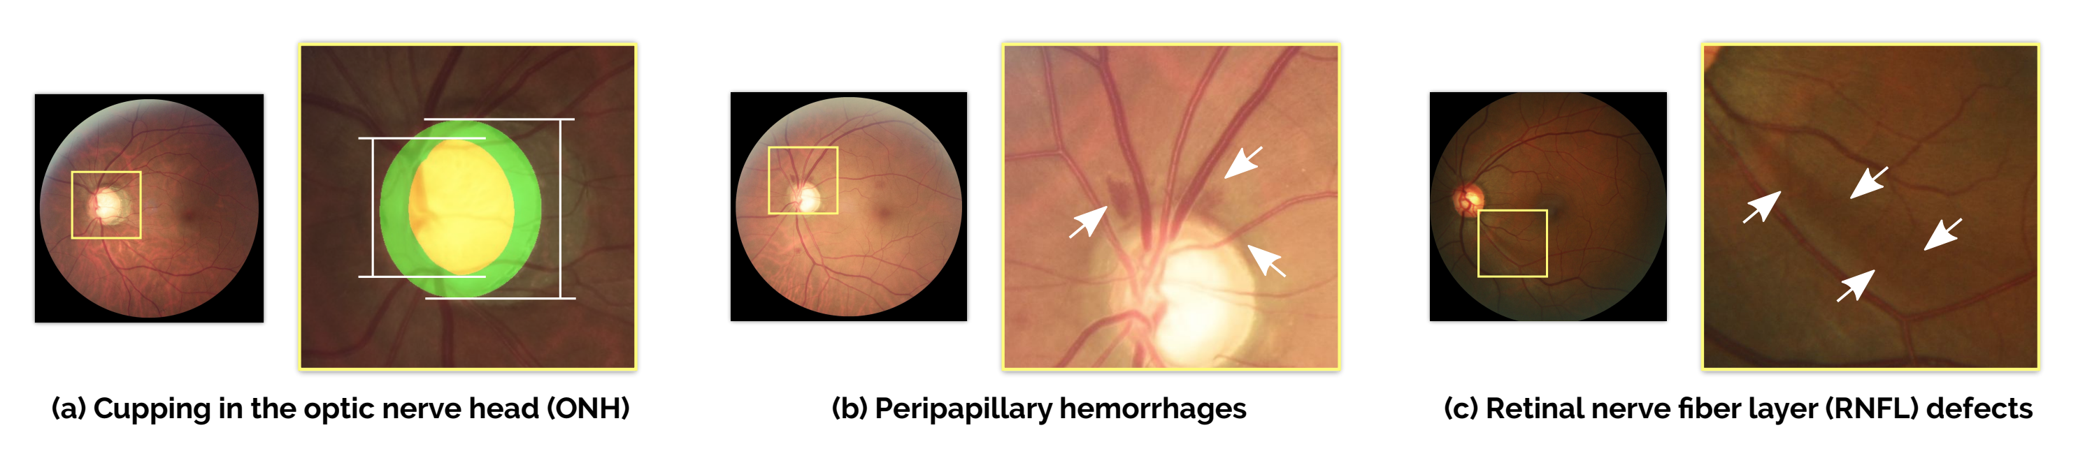
Annotations for other clinical signs
Lesions in images + Clinical parameters + Demographics + Why not clinical records?
Orlando et al., Medical Image Analysis, 2019

Slide 34
Conclusions

Slide 35
We need to go beyond just the optic disc
Target other features or even clinical parameters
AI is guided by data, so we need data!
Multicenter collaborations + Not just images
Advances in DR were boosted by open science
We need to (carefully, but still) release data and code!
Building a data set has to be the very first step
Invest time/money on preparing good data, then invest of developing the models!

Slide 36
That’s all!

Slide 37

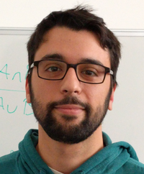
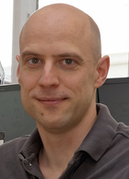
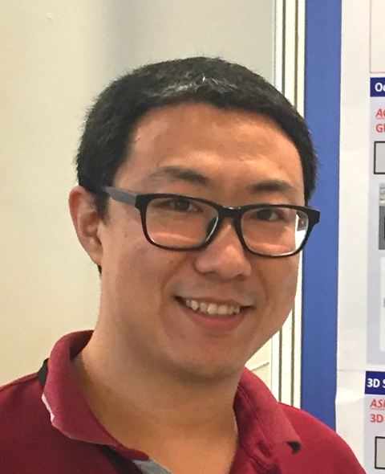


Y. Xu
J. I. Orlando
H. Bogunović
H. Fu
X. Zhang
F. Li

Slide 38

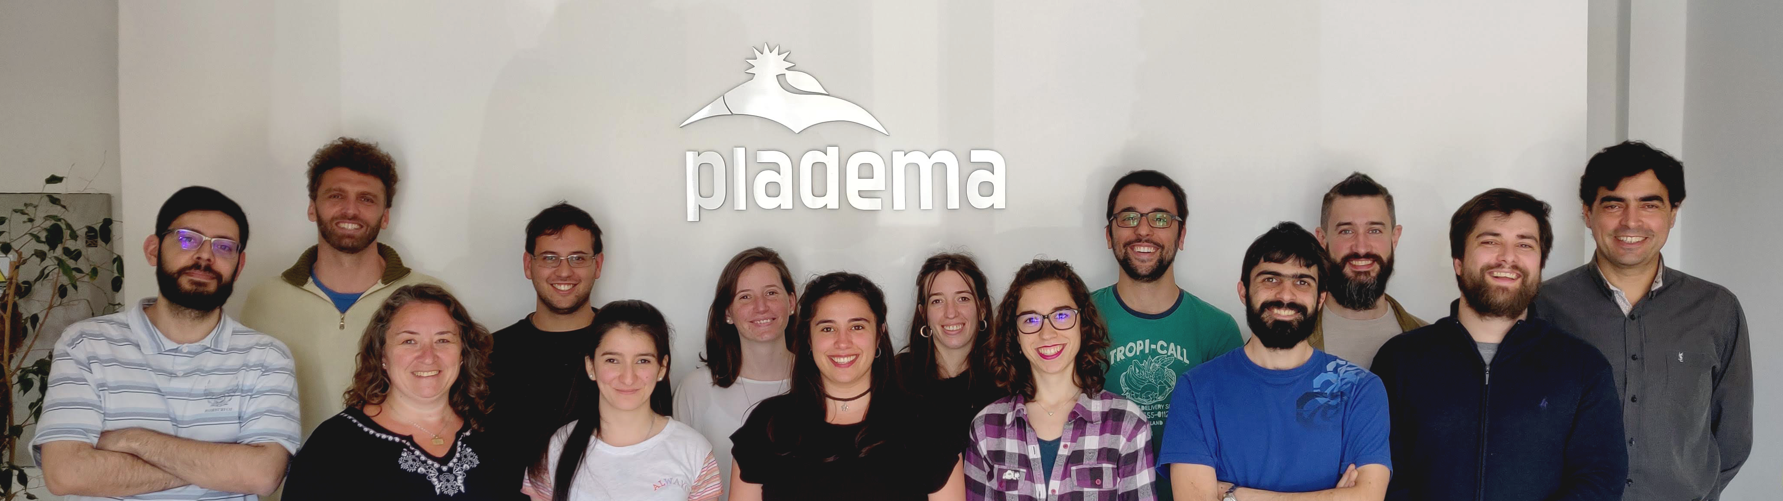


https://yatiris.github.io
@yatirisARG

Slide 39

Thanks for your attention!
If you have any further questions
https://ignaciorlando@github.io
jiorlando@pladema.exa.unicen.edu.ar
@ignaciorlando

